Slide 1
Physical Chemistry
Ying Hu
(Fifth edition)
Bilingual Program
版权所有：华东理工大学物理化学教研室

Slide 2
Part V Extension
Chapter 16
Electrolyte Solutions
Bilingual Program
版权所有：华东理工大学物理化学教研室

Slide 3
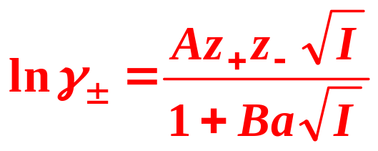
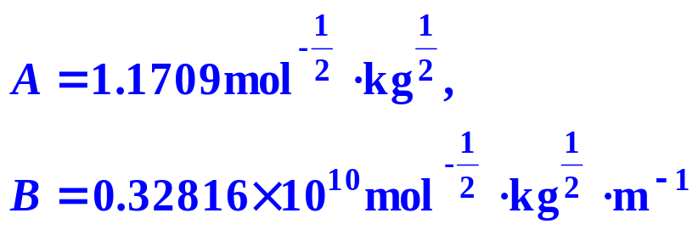

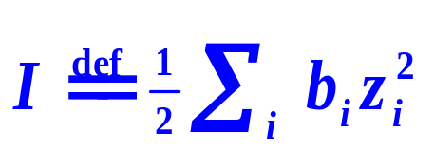
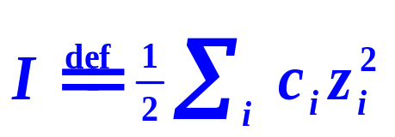
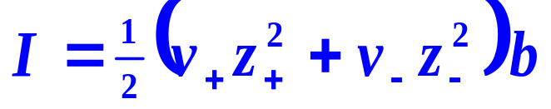



16.2 Activities of Electrolyte Solutions
Debye-Hückel Equation of Activity Factor
If the solvent is water, at 25°C,
For very dilute solution
Ionic Strength
Single component
There are three types of 1-1, 2-1, and 2-2 electrolytes in a solution, the relation of their mean ionic activity factors is .
A
B
C

Slide 4
16. Electrolyte Solutions
II. Transport Properties of Electrolyte Solutions
    16.5 Mechanism of Electric Conductance of Electrolyte Solutions
    16.6 Mobility and Transference Number of Ions
    16.7 Electric Conductivity
    16.8 Other Applications of Electric Conductance
    16.9 Diffusion in Electrolyte Solutions
    16.10 Theoretical and Semi-Empirical Methods

Slide 5
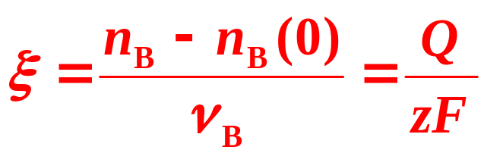
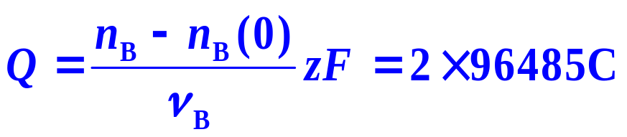
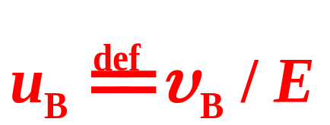
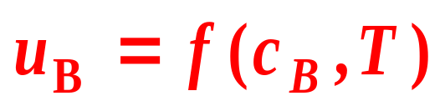
16.5 Mechanism of Electric Conductance of Electrolyte Solutions
Faraday’s Law
Mobility
Affecting Factors
cB↑, uB ↓; T↑, uB↑

Slide 6
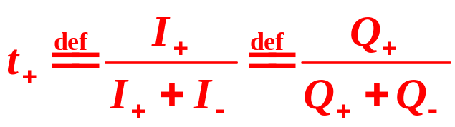
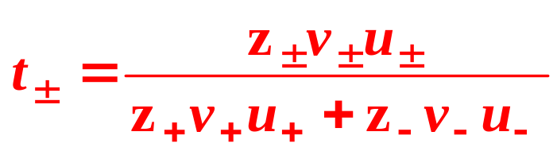
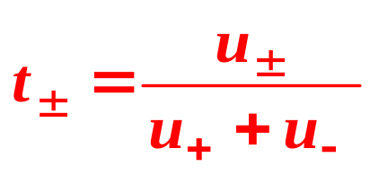
16.5 Mechanism of Electric Conductance of Electrolyte Solutions
Transference Number
For a symmetrical electrolyte

Slide 7
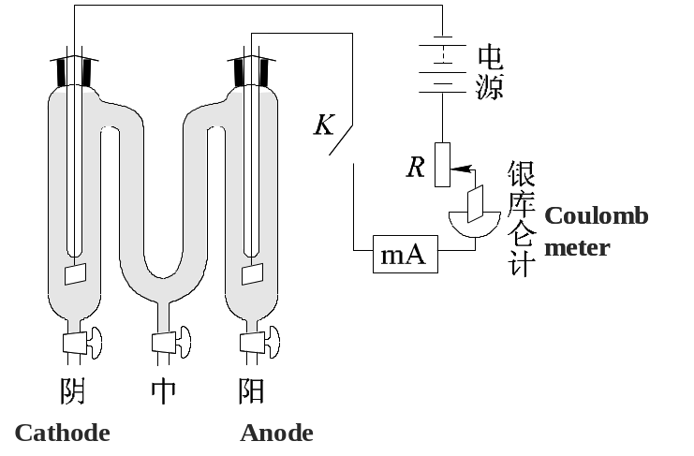


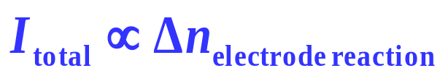
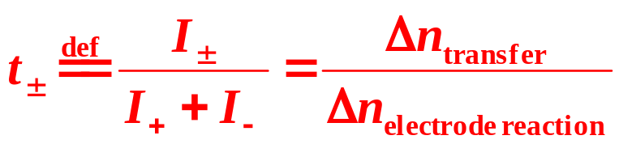
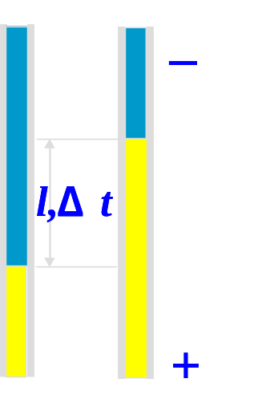
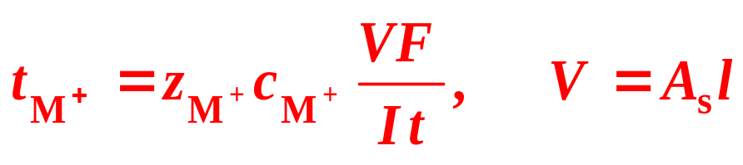
16.5 Mechanism of Electric Conductance of Electrolyte Solutions
Experimental Determination of Transference Number
(1) Hittorf Method
(2) Moving boundary method

Slide 8
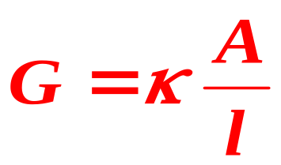
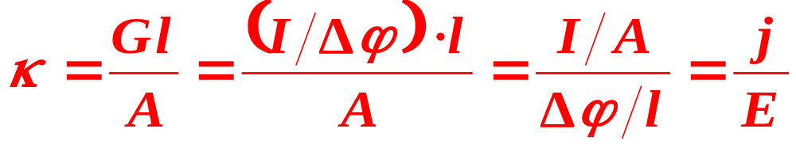
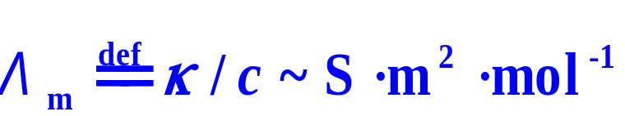
16.7 Electric Conductivity
Conductance (S)
Conductivity (Sm⁻¹)
Molar Conductivity (Sm² mol⁻¹)
Λ_{m}= (G/n) l²

Slide 9
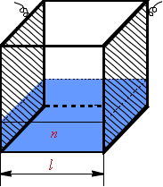
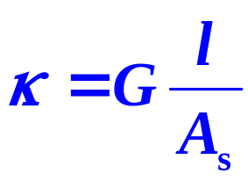
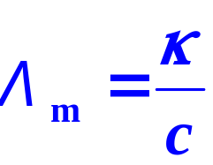
16.7 Electric Conductivity
Conductance G
Conductivity
Molar Conductivity
The conductance of a solution in unit electrode area and unit distance between electrodes.
The conductance of a unit concentration solution in unit distance between electrodes.

Slide 10
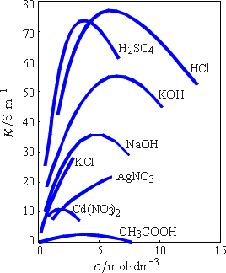
16.7 Electric Conductivity
Features of Electric Conductance of Electrolyte Solutions
(1) The electric conductivities of the strong acids and bases are among the largest, followed are those of the salts. Those of the weak electrolytes such as acetic acid (HAc) are the smallest due to their incomplete dissociation in solution.
(2) κ first increases with increasing c, after the maximum, it decreases.
Increasing concentration, the number of ions in unit volume also rises favoring the conductance, on the other hand, the interactions among ions strengthen weakening the conductance.

Slide 11
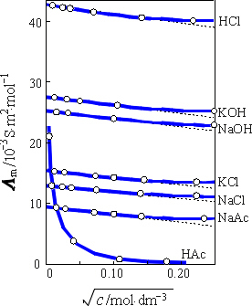
16.7 Electric Conductivity
Features of Molar Electric Conductance
Regardless of strong or weak electrolytes, Λ_{m} diminishes monotonically with increasing c.
For the strong electrolytes, the phenomenon attributes solely to the enhancement of ionic interactions with increasing c.
For the weak electrolytes, it is mainly because of the lowering of the degree of dissociation.
Variations of molar electric conductivity at 25 ℃ with square root of concentration

Slide 12
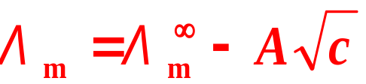

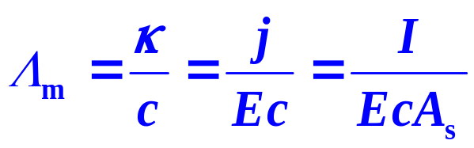
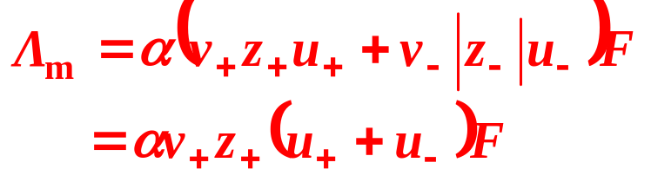
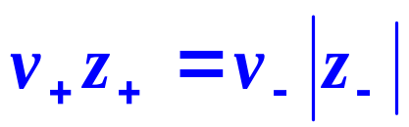
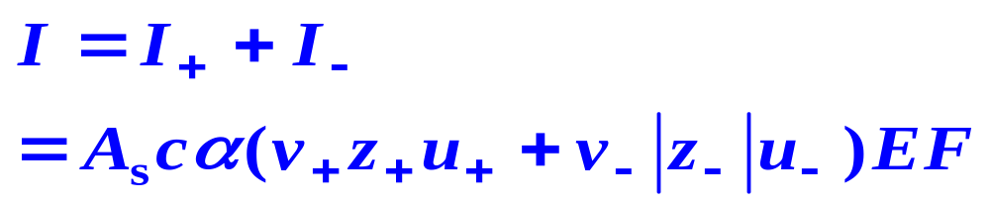
16.7 Electric Conductivity
Kohlrausch Relation
For the dilute solution of strong electrolytes
the molar electric conductivity at infinite dilution, is Λ_{m} when the concentration approaches zero.
Relation between Molar Electric Conductivity and Mobility

Slide 13

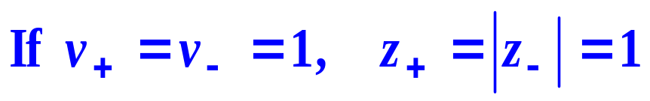

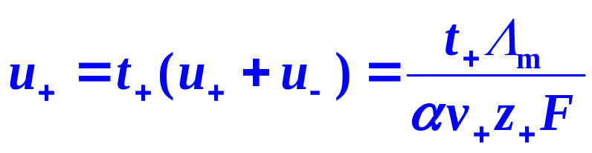
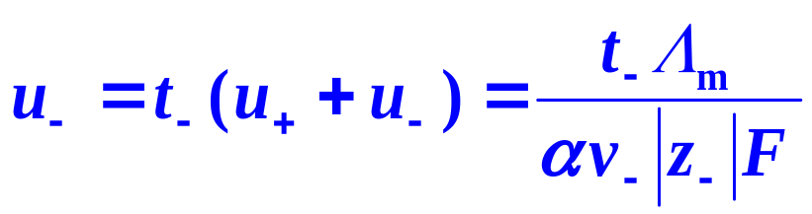
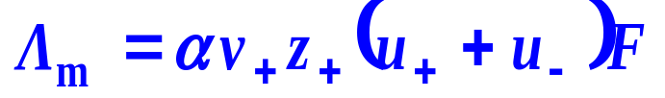
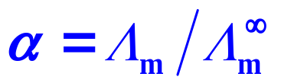
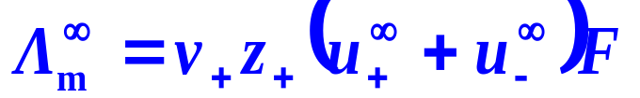
16.7 Electric Conductivity
Relation between Molar Electric Conductivity and Mobility
Calculate Mobilities by Molar Electric Conductivity and Transference Numbers
Calculate Dissociation Constant by Molar Electric Conductivity

Slide 14
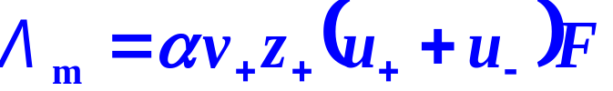
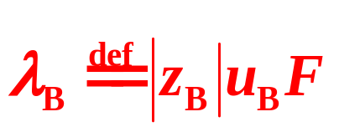
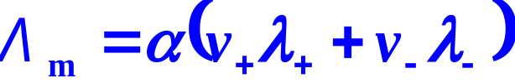
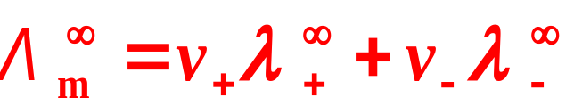
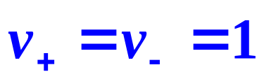
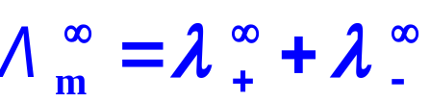
16.7 Electric Conductivity
3. Ionic Molar (Electric) Conductivity
Definition
Independent Migration Law of Ions
For very dilute solutions, the ionic molar conductivity is determined by the solvent, the temperature and the nature of the ion, irrelevant to other ions in solution.

Slide 15
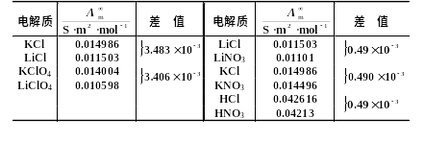

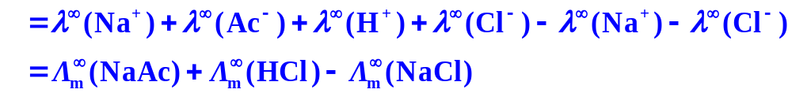
16.7 Electric Conductivity
Molar electric conductivities of infinite diluted solutions at 25 ºC
Solution
Difference
Solution
Difference

Slide 16

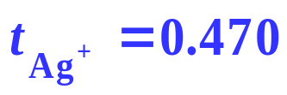
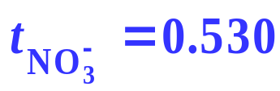
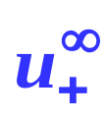
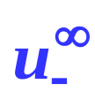
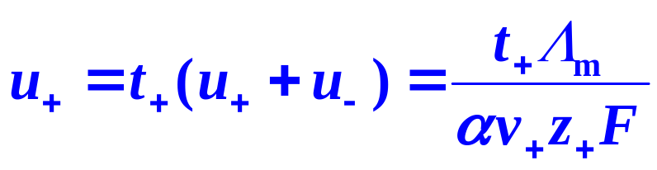
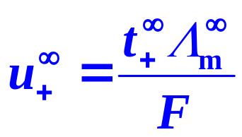


16.7 Electric Conductivity
Example
For an aqueous solution of AgNO₃ at 25°C, experiment gives
Combining with the transference number of and , calculate the mobilities at infinite dilution, and
？
Solution

Slide 17



16.7 Electric Conductivity
Example
Form the data of the ionic molar conductivity,
Calculate the mobilities at infinite dilution, and of Ag⁺ and NO₃⁻, respectively
Solution

Slide 18
16. Electrolyte Solutions
II. Transport Properties of Electrolyte Solutions
    16.5 Mechanism of Electric Conductance of Electrolyte Solutions
    16.6 Mobility and Transference Number of Ions
    16.7 Electric Conductivity
    16.8 Other Applications of Electric Conductance
    16.9 Diffusion in Electrolyte Solutions
    16.10 Theoretical and Semi-Empirical Methods

Slide 19





16.8 Other Applications of Electric Conductance
(1) Degree of Dissociation and Dissociation Constant of Weak Electrolytes

Slide 20



16.8 Other Applications of Electric Conductance
Example
,
.
The determination for the electric conductivity of electrolyte solution is actually by measuring its resistance. The relationship between electric conductivity κ and resistance R is κ=K_{cell}/R, in which K_{cell} is called the cell constant, with the unit of m⁻¹.
At 298.15 K, when the conductivity cell is filled by KCl solution, with the electric conductivity of 0.141 S·m⁻¹, the resistance is 525 Ω. And the resistance of the cell is 2030 Ω when filled by 0.1 mol·dm⁻³ NH₄OH solution. Calculate the degree of dissociation and the dissociation constant. Given that

Slide 21




16.8 Other Applications of Electric Conductance
Solution
，

Slide 22






16.8 Other Applications of Electric Conductance
(1) Degree of Dissociation and Dissociation Constant of Weak Electrolytes
Ostwald Dilution Law
plotting cΛ_{m} against 1/Λ_{m}
The slope and intercept can be used to calculate and K_{c}.

Slide 23




16.8 Other Applications of Electric Conductance
(2) Solubility and Solubility Product of Sparingly Soluble Salts
c is very small
Solubility
Solubility Product
For the 1-1 type sparingly soluble salt

Slide 24


16.8 Other Applications of Electric Conductance
Example
The electric conductivity of the saturated AgCl solution at 25 ºC is 3.41×10⁻⁴ S⋅m⁻¹ by experiment, that of the pure water at the same temperature is 1.60 ×10⁻⁴ S⋅m⁻¹. Calculate the solubility product of AgCl.
Solution

Slide 25






16.8 Other Applications of Electric Conductance
K_{sp} of Ag₂CrO₄ in water at 25°C is 9×10⁻¹² mol³⋅dm⁻⁹.
Calculate the solubility of Ag₂CrO₄ in water.
Calculate the solubility of Ag₂CrO₄ in a Na₂CrO₄ solution of 0.1mol⋅dm⁻³.
Example
Solution
(a) the solubility product is:
(b) Suppose the concentration of Na₂CrO₄ is c′, the solubility of Ag₂CrO₄ is c. Because the two salts have the same anion, the concentration of Ag⁺ is 2c, that of CrO₄²⁻ is c′+c,
c << 0.1mol⋅dm⁻³, c in the bracket can be neglected.
Therefore,
c=4.7×10⁻⁶ mol⋅dm⁻³.

Slide 26




16.8 Other Applications of Electric Conductance
(3) Ionic Product of Water
Water is a weak electrolyte, although the degree of dissociation is very small, water does have a certain electric conductivity as low as 5.5×10⁻⁶S⋅m⁻¹
Ionic Product of Water

Slide 27




16.8 Other Applications of Electric Conductance
Example
At 298K, the ionic product of water is K_{W}=1.008×10⁻¹⁴mol²·dm⁻⁶,
=0.02484S·m^{2·}mol⁻¹,
=0.04262S·m^{2·}mol⁻¹,
=0.01265S·m^{2·}mol⁻¹. Calculate the conductivity of water
Solution

Slide 28

16.8 Other Applications of Electric Conductance
(4) Determine the CMC of Ionic Surfactant Solution
The ionic surfactants will dissociate in the aqueous solution. The conductivity of the ionic surfactant solution increases with increasing the concentration of the surfactant. However, its increment reduces when surfactant molecules aggregate into micelles. From the intersect, the critical micelle concentration (CMC) can be obtained.
[C₈mim][Br]
[C₁₂mim][Br]
cmc
cmc

Slide 29
III. Reaction-Rate Properties of Electrolyte Solutions
Bilingual Program
版权所有：华东理工大学物理化学教研室

Slide 30
16. Electrolyte Solutions
Framework of the Chapter
    16.1 Introduction
    I. Equilibrium Properties of Electrolyte.
    16.2 Activities of Electrolyte Solutions
    16.3 Theories and Semi-Empirical Methods
    16.4 Applications
    II. Transport Properties of Electrolyte Solutions
    16.5 Mechanism of Electric Conductance of Electrolyte Solutions
    16.6 Mobility and Transference Number of Ions
    16.7 Electric Conductivity
    16.8 Other Applications of Electric Conductance
    16.9 Diffusion in Electrolyte Solutions
    16.10 Theoretical and Semi-Empirical Methods
    III. Reaction-Rate Properties of Electrolyte Solutions
    16.11 Ionic Reaction in Solution

Slide 31



16.11 Ionic Reaction in Solution
2. Effect of Ionic Strength
In the cases of 1, 2 and 3.
z_{A} and z_{B} have the same sign, z_{A}z_{B}>0, k increases with increasing ,
(2) In the cases of 5 and 6.
z_{A} and z_{B} have the opposite signs z_{A}z_{B}<0,, k decreases with increasing.
(3) In the cases of 4.
Reactant molecules are neutral without charge, z_{A}z_{B}=0,
k is irrelevant to

